Slide 1
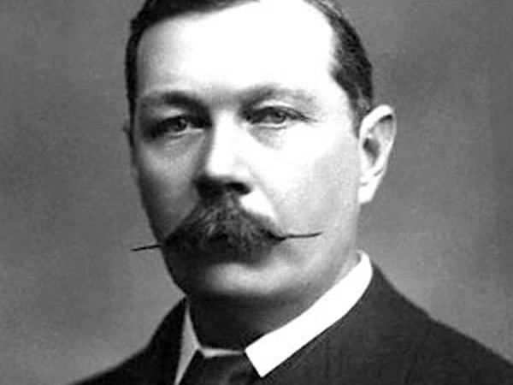
Sir Arthur Conan Doyle
https://vimeo.com/8721579

Slide 2
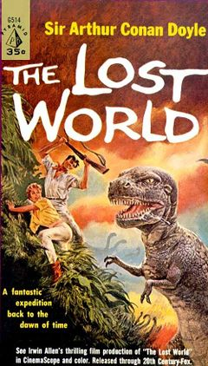

Slide 3
Continue the sentences:
Sir Arthur Conan Doyle was…
He had …
He wrote…

Slide 4
Check your answers
(ex 3 p 71)
motionless – not moving
glittered – shine
monstrous – huge
concealed – hidden
for – because
yelped – cried out
endure – put up with
gleam – sparkled
ecstasy – extreme happiness

Slide 5
The names of the groups are:
Insect:
Reptile:
Mammal:
Fish:
The creatures:
lizard, crocodile, fly, salmon, bee,
snake, elephant, dog, whale

Slide 6
Group work
The 1st group – Do ex 4 p 71
The 2nd group – do ex 5 p 71
The 3rd group – Do ex 6a p 71
The 4th group – Do ex 6b p 71

Slide 7
Check your answers
The 1st group
huge, enormous, monstrous, great, large

Slide 8
Check your answers
The 2nd group
classes: human, dinosaurs
parts of body: three-toed feet, five-fingered
forepaws, tails, feet, skins, muscles, brain,
heads, hand, cheeks, face
types: birds, elephants, lizards, kangaroos,
crocodiles, iguanas

Slide 9
Check your answers
The 3rd group
little children ― the two professors
elephants ― the baby dinosaurs
a human hand ― footprint of the dinosaur
a lizard, great beasts, crocodiles, kangaroos ―
the dinosaurs (iguanodons)

